Slide 1
Analytics Reports Available on 500 Different U.S. Industries. Updated Yearly.
www.plunkettresearch.com | info@plunkettresearch.com voice: 713.932.0000, fax: 713.932.7080

Slide 2
We Solve Data Needs!
• 7-Year History
• 7-Year Forecasts
• Complete Financial Metrics and Analytics
• Profits, Margins, COGS, EBITDA
• Top Firms Analyzed and Compared
• Covering 500 Industry Sectors
I Need Historic Market Growth
I Need Market Size Forecasts
I need Financial Metrics, Averages and Ratios
I need Profit Margins and EBITDA
I Need Benchmarks for Top Firms
I need Deep Data on a Niche Industry
User-Friendly Tools

Slide 3
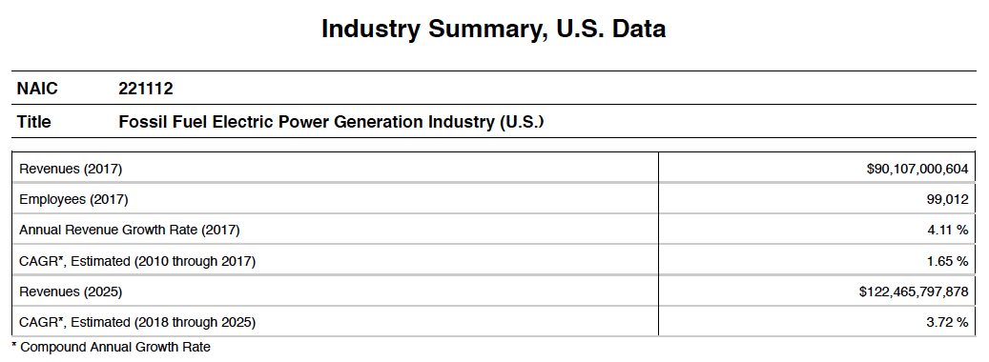
Each 60 to 70-Page Report Starts
With an Industry Summary
Market Size by Revenues, Latest Year
Growth-Rate, Latest Year
CAGR Past 8 Years
Market Size Projection 7 years
CAGR Next 7 Years

Slide 4
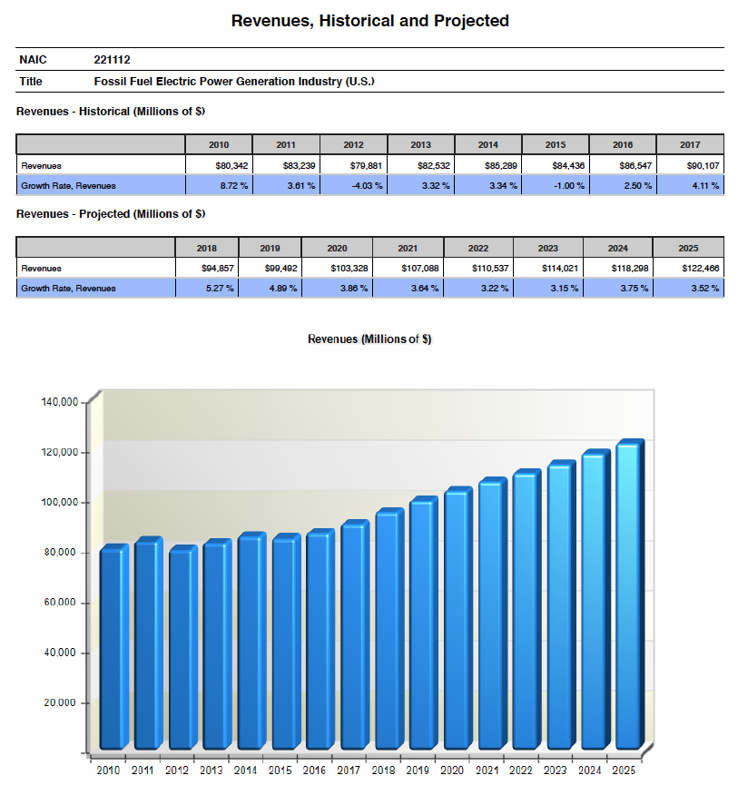

Slide 5
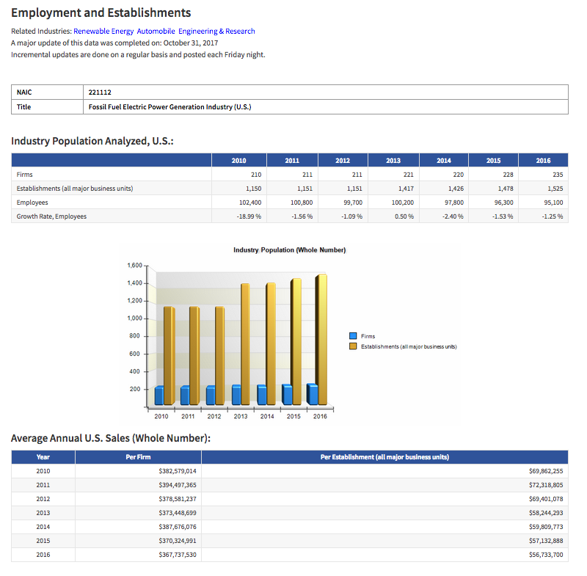
Deep History of Employment
Hard-to-find data includes revenues per employee and revenues per average firm.
We also provide market size history and projections.

Slide 6
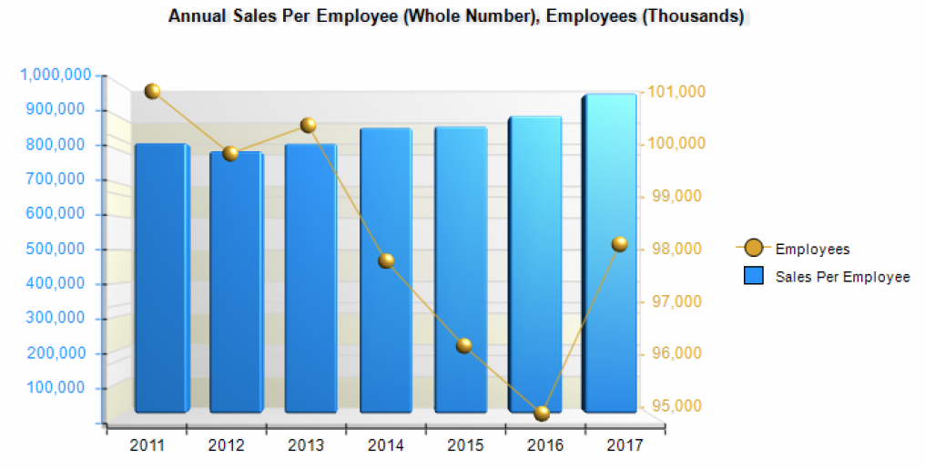
Sales Per Employee

Slide 7
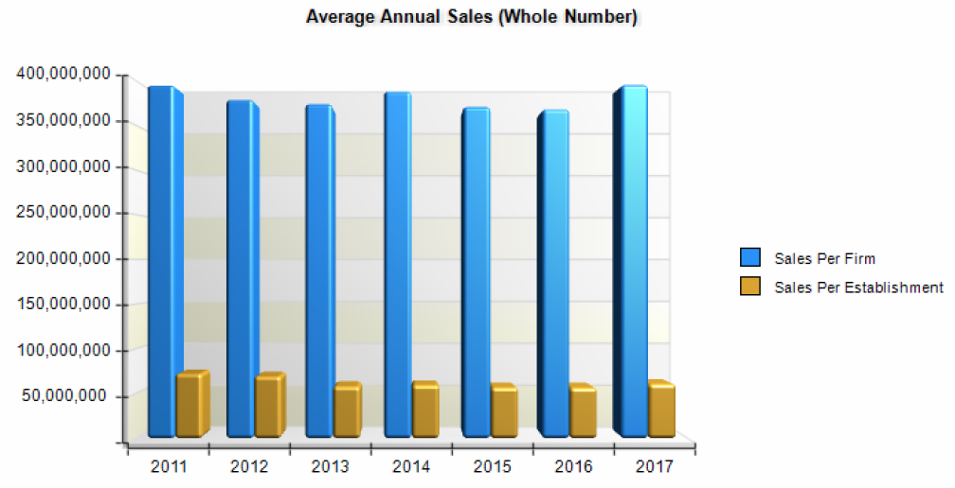
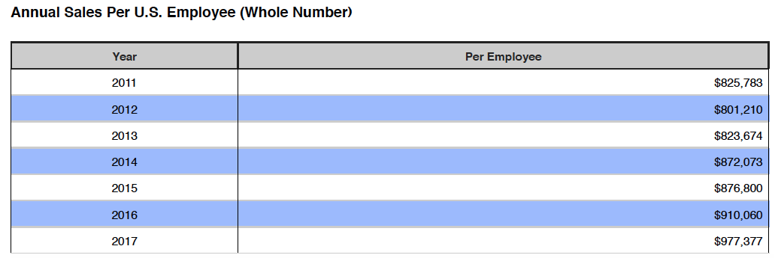
Sales Per Firm

Slide 8
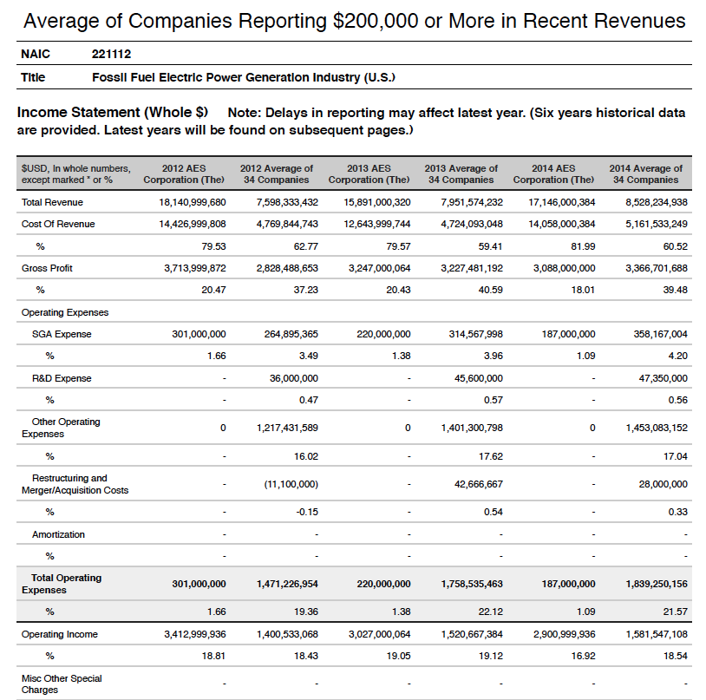
Multi-Year Financial Averages for the Industry’s:
Income Statement
Balance Sheet
Cash Flow Statement
A Complete History!

Slide 9
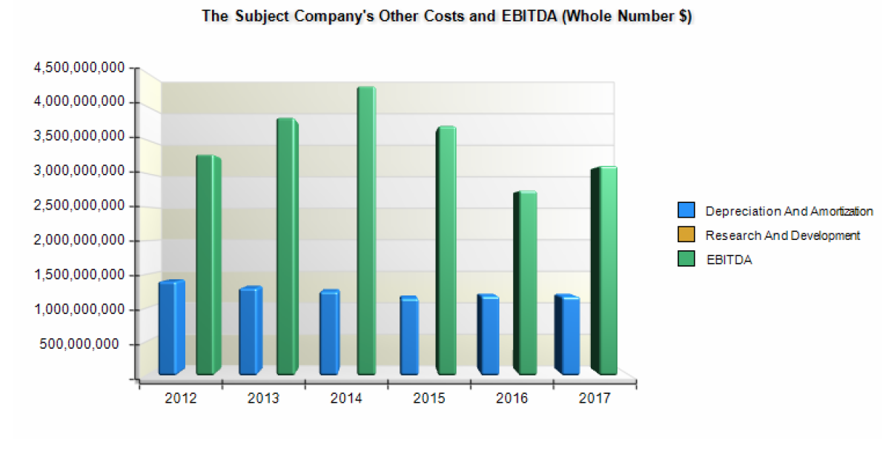
Historic EBITDA

Slide 10
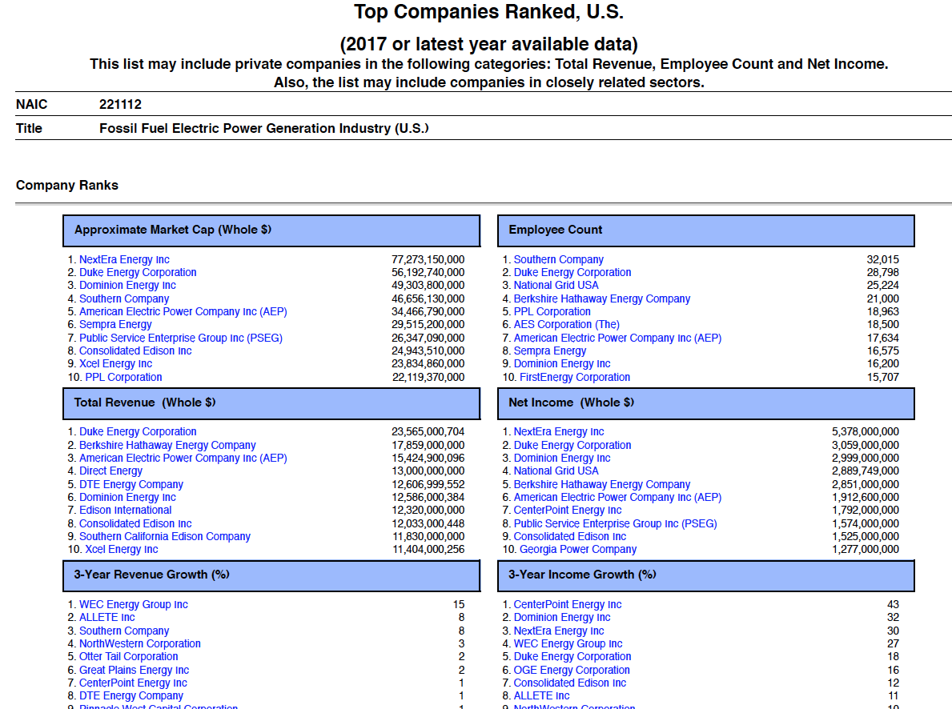
Top
Companies Ranked

Slide 11
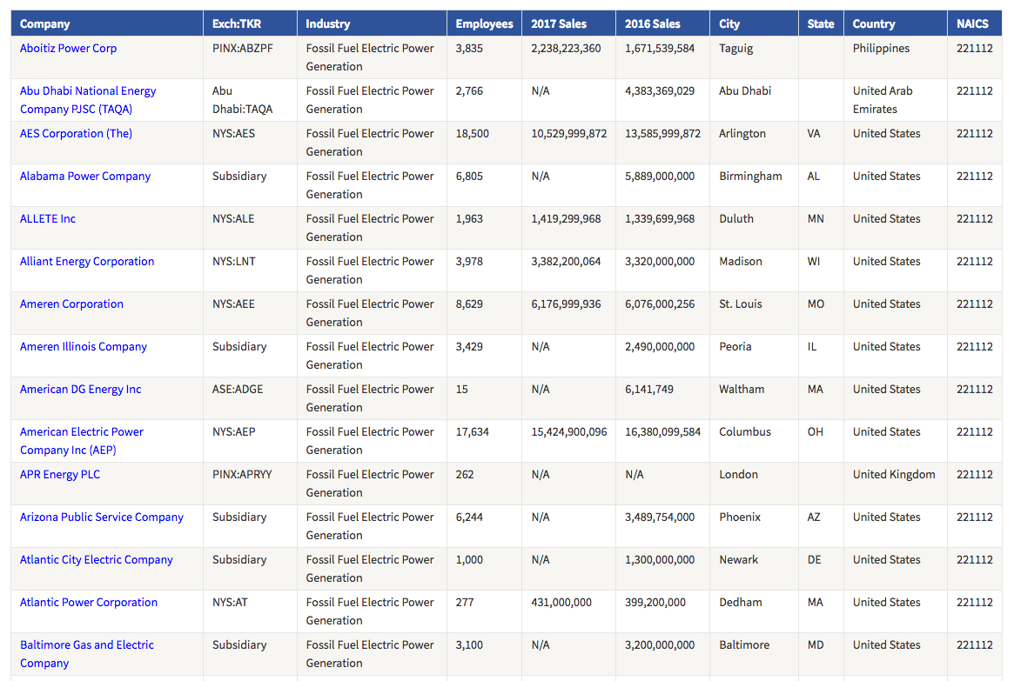
Includes a List of Companies
Used for Industry Averages
For hundreds of NAIC Industry Codes:
Industry revenues
Company count
Employee count
Historical revenues
Benchmarks
Financial metrics
Revenue forecasts

Slide 12
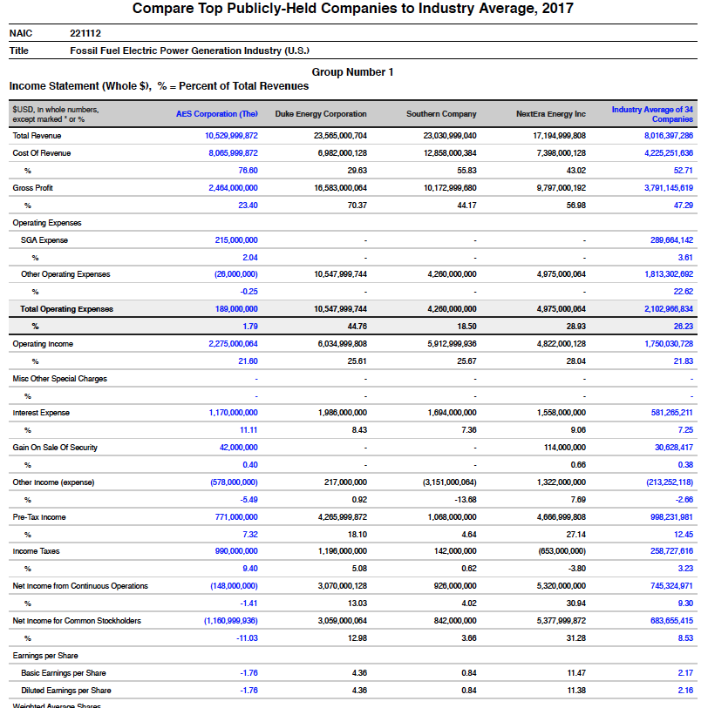
Top Companies Compared to Each Other and to the Industry Average
Income Statement
Balance Sheet
Cash Flow Statement

Slide 13
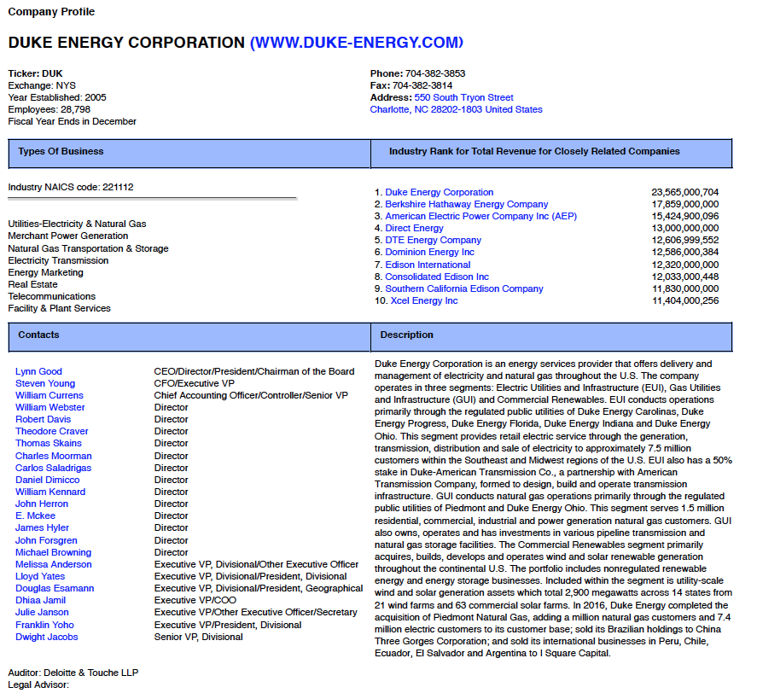
For the Industry’s
Top Firms:
Company Profile
Leadership
Historical Financials
Business Discussion

Slide 14
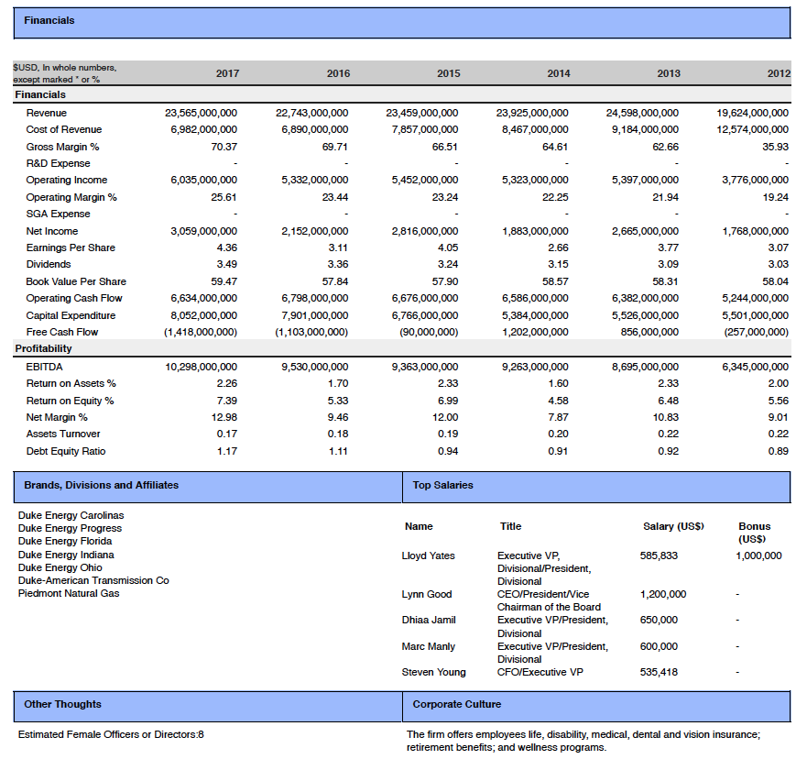
6-Year Financial Summary for
each Top Firm

Slide 15
Buyers Include the World’s top Consultancies,
Corporations and Investment Firms
Plunkett Analytics Saves Countless Hours of Effort and Solves Unique Data Needs for Specific Types of Buyers:
Banks and Other Lenders
M&A Advisors and Appraisers
Professionals
at Investment Banks
Consulting and Accounting Firms
Private Equity Firms
Analysts, Hedge Fund Professionals
VP of Strategy Needing Deep, Industry-Specific Data
☑
☑
☑
☑
☑
☑
☑

Slide 16
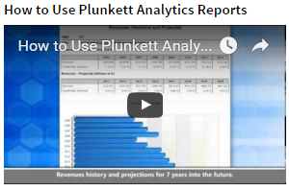
Helpful Videos
2-Minute Video Introduction, 6-Minute How-To
Our Market Research = Your Smart Decisions

Slide 17
Reports Available for All
American Industries
Listed by Industry Description and NAIC Code, Covering 500 Sectors.
Each Report is Updated At Least Once Each year.
• Advertising, Branding & Marketing
• Aerospace, Satellites & Drones
• Airlines, Hotel & Travel
• Alternative & Renewable Energy
• Apparel, Textiles & Fashion
• Artificial Intelligence
• Automobiles & Trucks
• Banking, Mortgages & Credit
• Biotechnology, Drugs & Genetics
• Canadian Industries
• Chemicals, Coatings & Plastics
• InfoTech, Computers & Software
• Consulting
• Consumer Products & Services,
Cosmetics, Household Products
• E-Commerce & Internet
• Education
• Energy & Utilities
• Engineering & Research
• Entertainment & Media
• Food, Beverage & Tobacco
• Games, Apps & Social Media
• Green Technology
• Health Care
• Insurance
• International Companies
• Internet of Things
• Investment & Securities
• Manufacturing & Robotics
• Medical Devices & Technologies
• Metals
• Outsourcing & Offshoring
• Private Companies
• Restaurant & Hospitality
• Real Estate & Construction
• Retailing
• Sharing Economy,
Freelance Workers,
On-Demand Delivery Services
• Sports
• Telecommunications
• Transportation & Supply Chain
• Wireless, Wi-Fi, RFID
& Cellular

Slide 18
Vital Data, Great Prices, & the
Outstanding Plunkett Brand
Each Report Covers 1 Industry
Updated and Republished Yearly
500 Reports Listed by NAIC and Industry Name
Per Industry Report: One-User, $1,995 Enterprise-Wide, $4,995
Complete dataset subscriptions available in XML and other formats.
www.plunkettresearch.com | voice: 713.932.0000 | fax: 713.932.7080 | info@plunkettresearch.com
Copyright © 2018, Plunkett Research, Ltd.

